Slide 1




PARTICIPANT PRESENTATION
Participant Details
Qiskit
Fall Fest
2026
PROJECT TITLE
Q-Sentinel –Hybrid Quantum-Classical Ai for Phishing URL Detection
TRACK
Quantum + Aiml
TEAM NAME
Claude Plan
TEAM LEADER
Narasimha Kulkarni
EMAIL / CONTACT
+91 8105043240
Hackathon · Team Details
TEAM MEMBERS
Member 1 – Narasimha Kulkarni
Member 2 – Kartik M Dhamanekar
INSTITUTION / ORGANISATION
Jain College of Engineering And Research Belagavi
COUNTRY
India

Slide 2
Problem Statement
Phishing links are becoming harder to identify, and many people unknowingly click on them and risk their personal information. Our project Q-Sentinel, aims to identify such links using machine learning and explore whether combining it with quantum computing can improve detection.

Slide 3
Objectives & Novelty
Objectives of Q-Sentinel
1.To develop a system that identifies potentially phishing URLs using machine learning.
2.To help users recognize suspicious links and reduce the risk of online scams.
3.To apply quantum machine learning techniques and compare their performance with traditional ML models.
Novelty of Q-Sentinel
Q-Sentinel combines traditional machine learning with quantum computing to explore a
new approach to phishing detection. Its main novelty is comparing both approaches on the
Same dataset to understand their performance, strengths, and limitations in real-world
cybersecurity.

Slide 4
Solution & Quantum Advantage
Solutions
Q-Sentinel analyzes the features of a URL to identify suspicious links and warn users about possible phishing attacks. It uses traditional machine learning and a quantum based model to compare compare their results and find a reliable way to detect fake links.
Quantum Advantages
We want to explore whether quantum computing can help improve phishing detection by identifying patterns that traditional models might miss. By comparing both approaches, we can understand where quantum machine learning may be useful and where traditional methods still perform better.

Slide 5
Algorithm
1. Input URL: User enters a link to check.
2. Feature Extraction: Extract URL details like length, special characters, HTTPS, and subdomains.
3. ML Prediction: A classical machine learning model predicts whether the URL is legitimate or phishing.
4. Quantum ML: A quantum-based model analyzes the same features for comparison.
5. Performance Evaluation: Compare both models using accuracy, precision, recall, and F1-score.
6. Display Result: Show the prediction and warn the user if the URL appears suspicious.
Key Details : Python, Scikit-learn, Qiskit, URL feature extraction, phishing detection, and
classical-versus-quantum
model comparison

Slide 6
Implementation & Tech Stack
Implementation
Q-Sentinel is implemented using Python to analyze URLs and identify possible phishing links. We extract useful details from each URL and use a machine learning model to classify it as legitimate or suspicious. We also plan to test a quantum-based model and compare its performance with the traditional model using actual experimental results.
Tech Stack
Python: Main programming language.
Pandas and Scikit-learn: Data handling, feature extraction, and machine learning.
Qiskit: Exploring the quantum machine learning approach.
Streamlit: Building a simple user interface.
Plotly: Displaying model performance and comparison charts.
Joblib: Saving and loading the trained model.

Slide 7
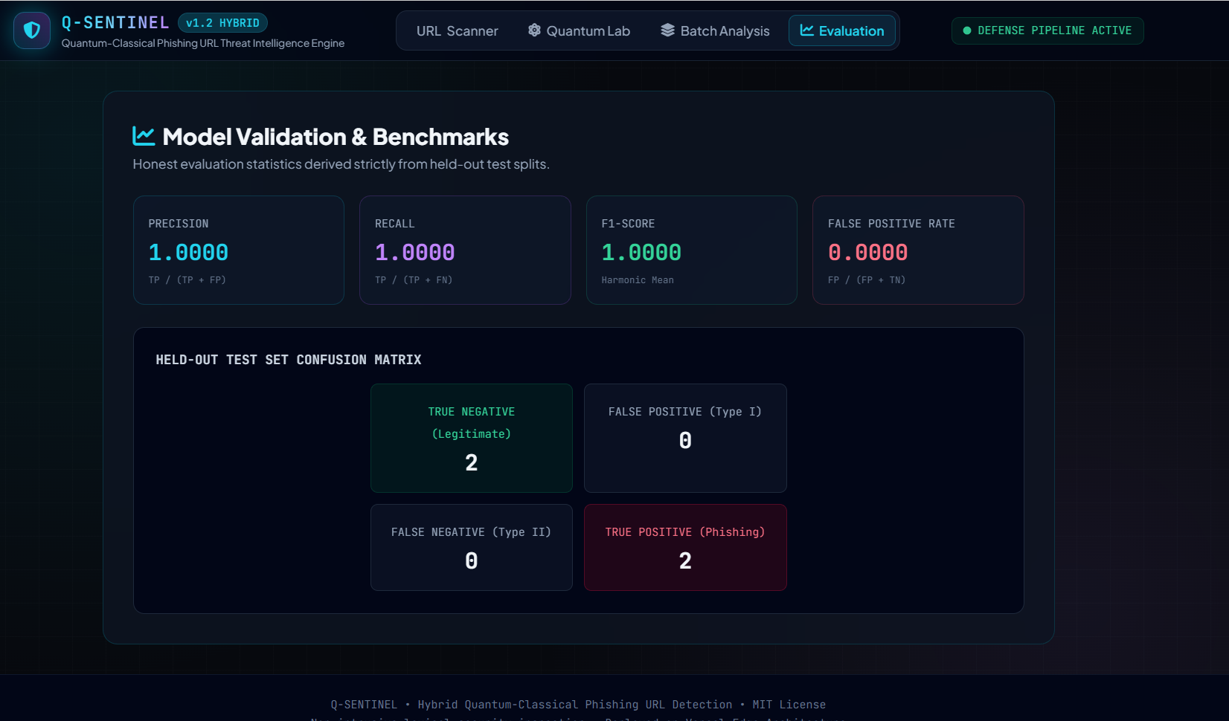
Results & Analysis
Add key details:
URL analysis: Extracts URL characteristics to identify suspicious patterns.
Classical ML: The project README identifies a Random Forest classifier using 12 lexical features.
Threat intelligence: The project is designed to use AlienVault OTX for additional threat information.
Quantum research: The project explores a hybrid quantum-classical approach, but this screenshot does not show quantum-model results.
Dashboard: Provides an Evaluation page for
viewing model metrics and the confusion matrix.
Insert results
Histogram, plot or table

Slide 8
Impact & Real-World Applications
Impact
Q-Sentinel aims to help people identify suspicious links before they share personal information or fall victim to online scams. It can improve awareness of phishing attacks and explore whether quantum machine learning can make link detection more effective.
Real-World Applications
Online Banking: Helps users spot potentially fake banking links.
Email Security: Identifies suspicious links received through emails.
Social Media: Helps users check links shared in messages and posts.
E-commerce: Helps detect potentially fraudulent shopping websites.
Cybersecurity: Can support security teams in identifying phishing threats.

Slide 9
Challenges & Future Scope
Challenges
Data Quality: Finding a reliable dataset containing both phishing and legitimate URLs.
Detection Accuracy: Identifying phishing links that look similar to genuine websites.
Quantum Limitations: Quantum machine learning can require more resources and may not outperform traditional models.
False Predictions: Avoiding incorrect warnings for safe links or missing harmful ones.
Future Scope
Improve detection using larger and more updated datasets.
Add real-time URL scanning and browser integration.
Develop a mobile application for easier access.
Extend detection to suspicious emails, fake websites, and other online scams.
Deploy the system as a scalable cybersecurity tool.

Slide 10
CLOSING
Thank You
Questions?
Inspiring Minds. Shaping Tomorrow.
GITHUB REPOSITORY
https://github.com/vtu-qiskit-fall-fest-2026/vtu-hc-clauds-plan
DEMO VIDEO https://youtu.be/LQtrbrABnbw?si=Ebv2eoGLbYADO3tcNK

